Slide 1
Employee Data Analysis using Excel
STUDENT NAME : ROHINI. R
REGISTER NO:312212853/unm2022g103
DEPARTMENT:B.COM (GENERAL)
COLLEGE:MAHALAKSHMI WOMEN’S COLLEGE OF ARTS AND SCIENCE

Slide 2
PROJECT TITLE
Employee Performance Analysis using Excel

Slide 3


AGENDA
Problem Statement
Project Overview
End Users
Our Solution and Proposition
Dataset Description
Modelling Approach
Results and Discussion
Conclusion
3/21/2024 Annual Review

Slide 4

PROBLEM STATEMENT
• DATA COLECTION & MANAGEMENT OF EMPLOYEE PERFORMANCE DATA.
• VISUALIZATION OF EMPLOYEE PERFORMANCE TRENDS & COMPARISIONS USING CHART, GRAPH & DASHBOARD.
• ANALYSIS OF PERFORMANCE MATRICS BY DEPARTMENT, TEAM, OR INDIVIDUAL.

Slide 5

PROJECT OVERVIEW
IDENTIFICATION OF TOP PRFORMERS, UNDERPERFORMER, & TRAINING NEEDS
DEPARTMENTAL & TEAM PERFORMANCE COMPARAISION.
PERFORMANCE MATIRIC CALCULATION & ANALYSIS.
DATA COLLECTION & MANAGEMENT

Slide 6

WHO ARE THE END USERS?
HR MANAGERS
DEPARTMENT HEADS
TEAM LEAD
EMPLOYEES
TALENT MANAGEMENT TEAMS
BY CONSIDERING THE NEEDS & REQUIREMENTS OF THESE END USERS, YOU CAN DESIGN AN EFFECTIVE EMPLOYEE PERFORMANCE ANALYSIS SYSTEM IN EXCEL

Slide 7

OUR SOLUTION AND ITS VALUE PROPOSITION
AUTOMATED PERFORMANCE TRACKING
CUSTOMIZABLE DASHBOARDS
DATA-DRIVEN INSIGHT
ENHANCED DECISION-MAKING
IMPROVED EMPLOYEE ENGAGEMENT
STREAMLINED PERFORMANCE MANAGEMENT
vSTRATEGIC WORKFORCE PLANNING

Slide 8
Dataset Description
EMPLOYEE INFORMATION TABLE
PERFORMANCE METRICS TABLE
PERFORMANCE EVALUATIONS TABLE
TRAINING & DEVELOPMENT TABLE
FEEDBACK & SURVEYS TABLE
SALES/PRODUCTION DATA TABLE
DATA TYPE INCLUEDS:
A. EMPLOYEER ID
B. DEPARTMENT
C. RATINGS
D. GOAL
E. COMMENTS

Slide 9

THE "WOW" IN OUR SOLUTION
AUTOMATED PERFORMANCE TRACKING:
EFFORTLESSLY MONITOR EMPLOYEE PERFORMANCE METRICS, ELIMINATING MANUAL DATA ENTRY
PREDICTIVE ANALYTICS:
IDENTIFY POTENTIAL PERFORMANCE ISSUES BEFORE THEY ARISE, ENABLING PROACTIVE INTERVENTIONS
CUSTOMIZABLE PERFORMANCE METRICS:
ALIGN METRICS WITH ORGANIZATION GOALS, ENSURING RELEVANT PERFORMANCE MEASUEMENT.
REAL TIME REPORTING:
GENERATE INSTANT REPORTS, FACILITATING TIMELY DECISION-MAKING
3/21/2024 Annual Review
9

Slide 10
MODELLING
REGRESSION ANALYSIS:
PREDICT EMPLOYEE PERFORMANCE BASED ON HYSTORICAL DATA.
CLUSTER ANALYSIS:
GROUP EMPLOYEES WITH SIMILAR PERFORMANCE
CHARACTERISTICS
DECISION TREES:
IDENTIFY KEY FACTORS INFLUENCING EMPLOYE PERFORMANCE
CONDITIONAL FORMATTING:
HIGHLIGHT PERFORMANCE TREND & OUTLINES
PIVOT TABLES:
ANALYZE & SUMMARIZE LARGE DATASETS
10

Slide 11
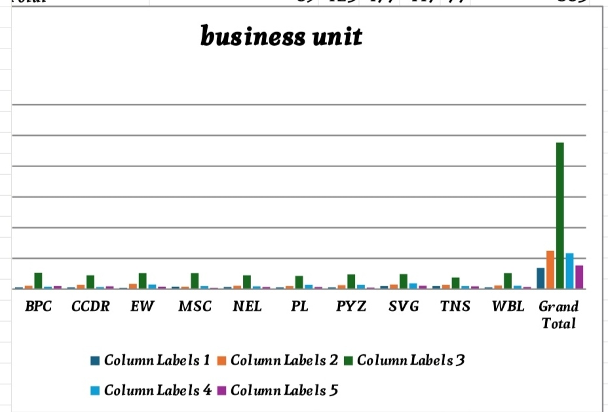
RESULTS
11

Slide 12
conclusion
EMPOWERS DATA DRIVEN DECISION MAKING ENHANCE PERFORMANCE MANAGEMENT BOOSTS EMPLOYEE ENGAGEMENT AND GROWTH
BY LEVERAGING EXCEL FOR EMPLOYEE PERFORMANCE ANALYSIS , ORGANIZATION.
UNLOCK EMPLOYEE POTENTIAL DRIVE BUSINESSSUCESS STAY COMPETITIVE IN THE MARKET
EMBRACE DATA DRIVEN PERFORMANCE MANAGEMENT & EMPOWER YOUR WORK FORCE TO EXCE

